Slide 1

Letters game presentation

Slide 2


Project goal –
(what result did the customer want to get?)
To make a game for small children
The game has letters “b” and “d’
When u touch “b” you win
If u clicked “d” you lose
Presentation
of the project

Slide 3
Particular features of the project
(The program interface is simple and functional ...)
The game has letters “b” and “d’
Each letter inside 3d circle
Red circle for “d”
Light-blue circle for “b”
The circles moves randomly
Presentation
of the project

Slide 4
Particular features of the project
(Extras: auto-restart of the game, increased difficulty ...)
Theres is auto-restart
Increase in difficulty for example:
Make the game gets be random each time or move faster
Presentation
of the project

Slide 5
Project prospects
(Will the game make profit? Any possible improvements?)
Maybe 100-50 pounds at least
Maybe,for example adding more letters
Presentation
of the project

Slide 6
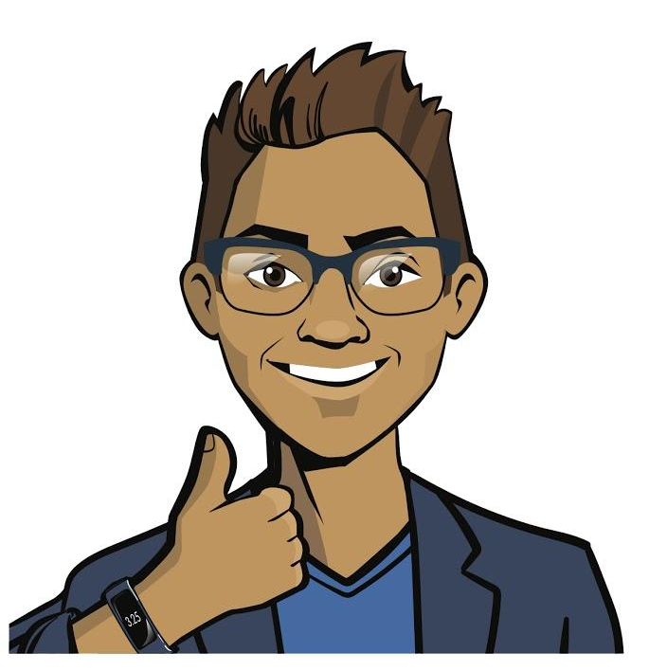
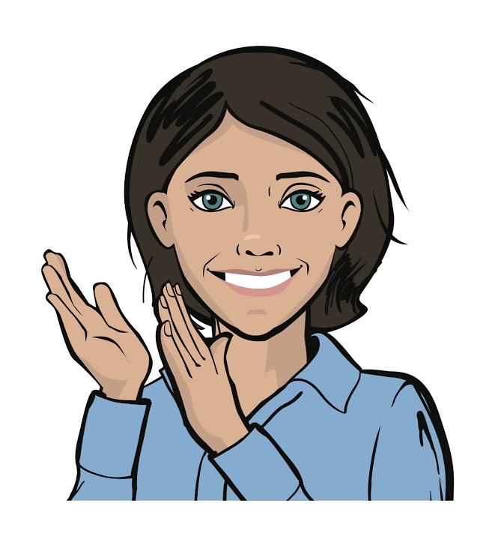
Thank you for your attention
We will be glad to answer your questions and receive feedback.
Presentation
of the project

